Slide 1
Brain Flexor: Improving Sentences #4
Today’s Destination:
L 1a: I can use parallel structure.
L 2a I can use a semicolon to link two or more related independent clauses.

Slide 2
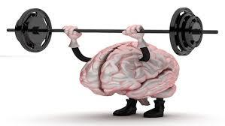
BF: Improving Sentences #4
Define parallel structure.
Parallel? Why or why not? Fix error if necessary.
Chelsea had to paddle past a school of jellyfish, kick a small sand shark in the nose, and untangling seaweed from her surfboard before she reached her favorite point break.
Parallel Structure
SAT Grammar Prep/ParallelStructure.pdf
When can you use a semicolon?
Correct use of semicolon? Fix error if necessary.
Grandma still rides her Harley motorcycle; her toy poodle balances in a basket between the handlebars.
Semicolons
SAT Grammar Prep/Punctuation.pdf

