Slide 1
Brain Flexor: Sentence Structure #1
Today’s Destination:
L 1b: I can use various types of phrases and clauses to convey meaning and add variety and interest to my writing
L 2a I can use a semicolon to link two or more related independent clauses

Slide 2
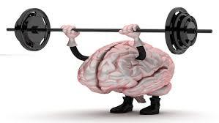
BF: Sentence Structure #1
What is a simple sentence?
What is a compound sentence?
What is a complex sentence?
What is a compound-complex sentence?
Identify the following sentences as simple, compound, complex, compound-complex & underline the simple subject 1x and simple predicate 2x:
After the sun set, Alex and Lizzie walked hand-in-hand down the beach.
Alex and Lizzie walked down the beach, and they continued to enjoy each other’s company.
Walking down the beach relaxed Alex and Lizzie.
As last night’s game ended, the bases were loaded, and Bob hit a grand slam.

