Slide 1
Brain Flexor: Grammar #1
Today’s Destination:
L 1b: I can use various types of phrases and clauses to convey meaning and add variety and interest to my writing
L 2a I can use a semicolon to link two or more related independent clauses

Slide 2
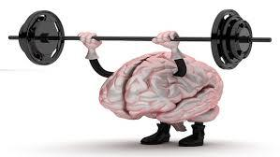
BF: Grammar #1
What makes a sentence complete?
A sentence is comprised of what two parts?
What is a sentence fragment?
What is a run-on sentence?
Identify the following sentences as complete, fragment, or run-on:
Simon, an avid reader, which made him smart.
Simon, an avid reader, enjoyed Science fiction most of all.
Simon, an avid reader, enjoyed Science fiction he wrote stories, too.

