Slide 1
Elements of Voice

Slide 2
Literary Techniques Used to Create VOICE in Writing
Voice is the color and texture of communication – the pitch and timbre of verbalization.
6 different students (3 male, 3 female) will say, “Hello, my name is ______________.”
What differences did you hear in the sound of each voice?
PITCH – high, medium, low (soprano, alto, tenor, bass)
TIMBRE (quality) – raspy, nasal, resonant, shrill, rich, mousy
VOLUME – soft, medium, loud
How does this relate or compare to musical instruments?
Think about guitars, drums, trumpets, flutes, violins………
VOICE is the fingerprint of a person’s language. What do we know about fingerprints?
Understanding voice helps us appreciate the richness of language and understand the deeper meaning of literature. VOICE in WRITING is created through the use of DICTION, DETAIL, IMAGERY, SYNTAX, and TONE.

Slide 3
DICTION
Diction refers to the author’s choice of words.
Effective voice is shaped by words that are clear, concrete, and exact.
Good writers exchange words like pretty, caring, and bad
for words like stunning, compassionate, and horrible.
A coat is not torn; it is tattered.
The Army does not want revenge; it is thirsting for revenge.
A door does not shut; it slams.
Specific DICTION brings the reader into the scene, enabling full participation in the writer’s world.
DICTION is determined by topic, purpose, and occasion.

Slide 4
DICTION
TOPIC – what author writes about; the topic determines the specificity and sophistication of diction or word choice.
How would the DICTION be different in the following pieces of writing:
an article about computers
an article in a medical journal
a text message to a friend
an e-mail to the boss
a story about dating
a story about fighting
a story about aliens

Slide 5
DICTION
Writer’s PURPOSE – why the author is writing; whether to convince, to entertain, to amuse, to inform, or to plead – determines diction.
For example, if an author’s purpose is to inform, the reader should expect straightforward, matter-of-fact diction. On the other hand, if the author’s purpose is to entertain, the reader will encounter words that are used in playful ways.

Slide 6
DICTION
OCCASION – the author’s reason for writing; as with clothes, level of formality influences appropriate word choice.
LEVELS of FORMALITY:
formal – academic, scholarly, serious prose and poetry, business correspondence
informal – newspaper editorials, personal e-mails, works of fiction
slang (colloquial) – text messages, dialect, speech with friends,

Slide 7
DICTION
When studying diction, one must understand both the:
denotation - the literal meaning or dictionary definition of words
AND THE
connotation - the idea or feeling suggested by words
The man slept forever in his eternal bed.
Slept: Denotation is _____________. Connotation is _______________.
Bed: Denotation is ______________. Connotation is ______________.

Slide 8
DICTION
Finally, DICTION impacts originality in writing. Words used in surprisingly or unusual ways make us rethink what is known and re-examine meaning. Good writers often opt for complexity rather than simplicity, for multiple meanings rather than one meaning. DICTION, the foundation of voice, shapes a reader’s thinking while guiding reader insight into the author’s expression of thought: the writer’s voice.

Slide 9
Let’s practice.
What words would you use to describe the next slide?

Slide 10
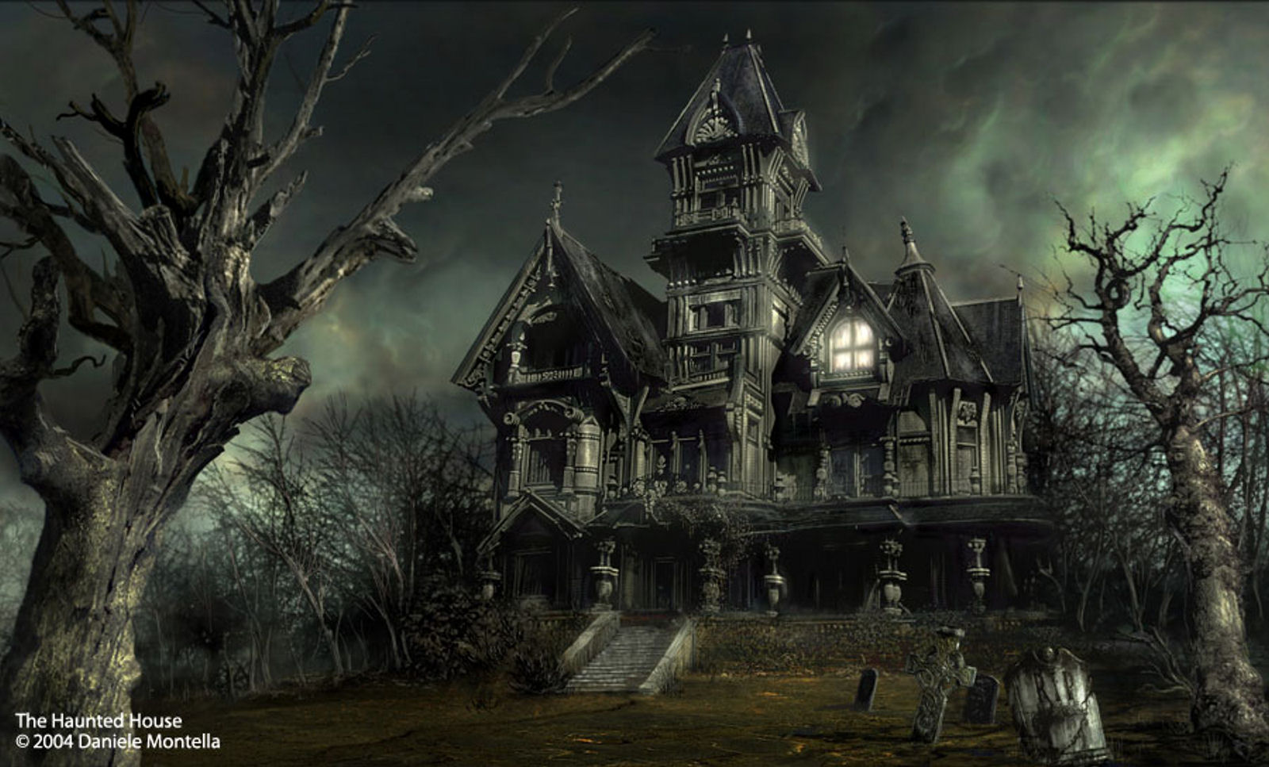

Slide 11
During the whole of a dull, dark, and dreary day in the winter of the year, when the clouds hung oppressively low in the heavens, I found myself, as shades of the evening drew on, within view of the decrepit haunted house. I know not how it was –but, with the first glimpse of the building, a sense of insufferable gloom pervaded my spirit. I looked upon the scene before me –upon the forsaken house, and the desolate landscape—upon the black walls—upon the vacant eye-like windows—upon the decayed trees– with an utter depression of the soul and pondered on the bitterness of life.
adapted from Fall of the House of Usher
by Edgar Allan Poe

Slide 12
What words would you use to describe the next slide?

Slide 13
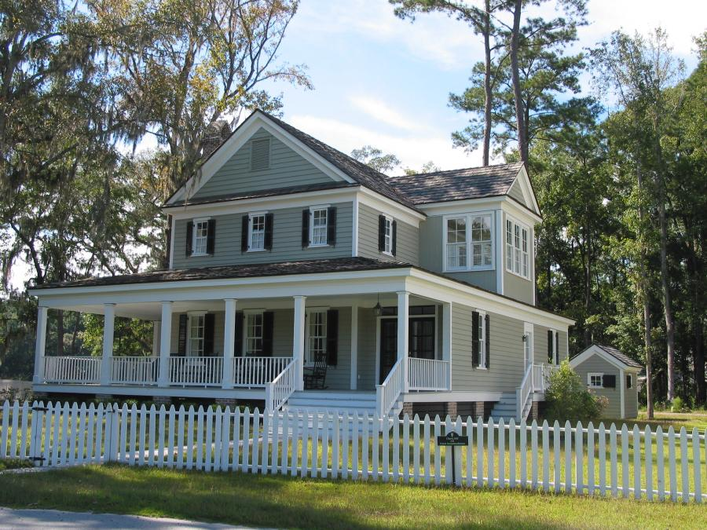

Slide 14
Let’s review.
So what is DICTION and what does it do?
author’s word choice
brings the reader into the scene
defines the topic (subject) , occasion (reason), and purpose (why) - of writing
impacts originality in writing

Slide 15
Detail
Detail (facts, observations, and incidents) is used to develop a topic, shaping and seasoning voice.
Specific details refer to fewer things than general descriptions, thereby creating a precise mental picture.
Detail brings life and color to description, focusing the reader’s attention and bringing the reader into the scene.
Because detail encourages readers to participate in the text, use of detail influences reader’s views of the topic, the settings, the narrator, and the author.
Detail shapes reader attitude by focusing attention: the more specific the detail, the greater the focus on the object described.

Slide 16
Detail
Detail makes an abstraction concrete, particular, and unmistakable, giving the abstraction form.
For example, when Orwell describes an elephant attack, the attack comes alive through the elephant’s specific violent actions.
By directing readers’ attention to particulars, detail connects abstraction to their lives: to specifics they can imagine, have participated in, or understand vicariously.
Detail focuses description and prepares readers to join the action.
As a result, readers can respond with conviction to the impact of the writer’s voice.

Slide 17
Detail
Detail can also state by understatement, by a lack of detail.
The absence of specific details, for example, may be in sharp contrast to the intensity of a character’s pain.
In this case, elaborate, descriptive detail could turn the pain into sentimentality.
Good writers choose detail with care, selecting those details which add meaning and avoiding those that trivialize or detract.

Slide 18
VOICE in WRITING is created through the use of
DICTION, DETAIL, IMAGERY, SYNTAX, and TONE.
IMAGERY is the verbal representation of all five senses:
SIGHT: visual imagery
The sky looked like the untouched canvas of an artist.
The fighter jet swooped down like an eagle after its prey.
SOUND: auditory imagery
The eerie silence was shattered by her scream.
He could hear the footsteps of doom nearing.
TOUCH: tactile imagery
He could never escape from the iron grip of desire.
The lake shivered with the touch of the wind.
TASTE: gustatory imagery
The taste of that first defeat was bitter indeed.
The salty taste of tears was a constant reminder of her loss.
SMELL: olfactory imagery
She was a breath of fresh air.
The smell of freshly baked chocolate chips cookies filled the air.

Slide 19
What examples of imagery are in the text below?
During the whole of a dull, dark, and dreary day in the winter of the year, when the clouds hung oppressively low in the heavens, I found myself, as shades of the evening drew on, within view of the decrepit haunted house. I know not how it was –but, with the first glimpse of the building, a sense of insufferable gloom pervaded my spirit. I looked upon the scene before me –upon the forsaken house, and the desolate landscape—upon the black walls—upon the vacant eye-like windows—upon the decayed trees– with an utter depression of the soul and pondered on the bitterness of life.
adapted from Fall of the House of Usher
by Edgar Allan Poe

Slide 20
YOU TRY!
Write a sentence of imagery for
SIGHT
SOUND
TOUCH
TASTE
SMELL
Share two examples with your shoulder partner.

Slide 21
VOICE in WRITING is created through the use of
DICTION, DETAIL, IMAGERY, SYNTAX, and TONE.
SYNTAX refers to the way words are arranged within sentences.
Syntax encompasses changes and variety in:
WORD ORDER
Traditional grammatical structure (natural) vs. non-traditional grammatical structure (inverted)
I am hungry vs. Hungry am I.
SENTENCE LENGTH (Types of Sentences & Fragments for Effect)
Long vs. Medium vs. Short vs. Very Short vs. One Word
SENTENCE FOCUS
Placement of the main idea – beginning (loose) or end (periodic) and Repetition
PUNCTUATION
Used to reinforce meaning, construct effect, and express the writer’s voice
-especially dashes, colons, and semicolons

Slide 22
Analyze syntax - sentence word order, length, focus, and punctuation – in the passage below:
During the whole of a dull, dark, and dreary day in the winter of the year, when the clouds hung oppressively low in the heavens, I found myself, as shades of the evening drew on, within view of the decrepit haunted house. I know not how it was –but, with the first glimpse of the building, a sense of insufferable gloom pervaded my spirit. I looked upon the scene before me –upon the forsaken house, and the desolate landscape—upon the black walls—upon the vacant eye-like windows—upon the decayed trees– with an utter depression of the soul and pondered on the bitterness of life.
adapted from Fall of the House of Usher
by Edgar Allan Poe

Slide 23
VOICE in WRITING is created through the use of
DICTION, DETAIL, IMAGERY, SYNTAX, and TONE.
TONE is the expression of attitude.
It is the writer’s (or narrator’s) implied attitude toward his subject and audience.
The writer creates tone by selection (diction) and arrangement (syntax) of words, and by purposeful use of details and images. The reader perceives tone by examining these elements.

Slide 24
What is the speaker’s attitude toward life in the passage below? What images and diction support your position?
During the whole of a dull, dark, and dreary day in the winter of the year, when the clouds hung oppressively low in the heavens, I found myself, as shades of the evening drew on, within view of the decrepit haunted house. I know not how it was –but, with the first glimpse of the building, a sense of insufferable gloom pervaded my spirit. I looked upon the scene before me –upon the forsaken house, and the desolate landscape—upon the black walls—upon the vacant eye-like windows—upon the decayed trees– with an utter depression of the soul and pondered on the bitterness of life.
adapted from Fall of the House of Usher
by Edgar Allan Poe

Slide 25
SUMMARY
Understanding voice helps us appreciate the richness of language and understand the deeper meaning of literature.
VOICE in WRITING is created through:
DICTION – word choice
DETAIL – facts, observations, and incidents (more later)
IMAGERY – verbal representation of sense experience
SYNTAX – how words are arranged in the sentence
TONE – expression of the writer’s, narrator’s or speaker’s attitude

Slide 26
Writing with Voice
“I’m boiling with rage, and yet I mustn’t show it. I’d like to stamp my feet, scream, give Mummy a good shaking, cry, and I don’t know what else, because of the horrible words, mocking looks, and accusations which are leveled at me repeatedly every day, and find their mark, like shafts from a tightly strung bow, and which are just as hard to draw from my body.”
--Anne Frank, The Diary of a Young Girl

Slide 27
Writing with Voice
“I’m boiling with rage, and yet I mustn’t show it. I’d like to stamp my feet, scream, give Mummy a good shaking, cry, and I don’t know what else, because of the horrible words, mocking looks, and accusations which are leveled at me repeatedly every day, and find their mark, like shafts from a tightly strung bow, and which are just as hard to draw from my body.”
Diction Syntax. Detail Imagery

Slide 28
Inference:
A logical assumption, derived by reasoning, based on observable facts and evidence and one’s own knowledge.

Slide 29
Works Cited
Dean, Nancy. Voice Lessons Classroom Activities to Teach Diction, Detail, Imagery, Syntax,
and Tone. Florida: Maupin House, 2000.

